Slide 1
Capstone Project - The Battle of Neighborhoods
Bogotá and Cundinamarca case study

Slide 2
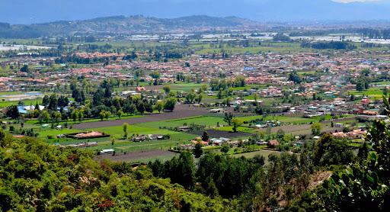
Business Problem
- Finding the correct place as per requeriments stakeholder to open Butcher shop in Bogotá or Cundinamarca
-Clustering the cities and neighborhoods of Bogota that show the venues which are the most visited such as restaurants and steakhouses.

Slide 3
Data
obtain the data of the coordinates of the neighborhoods of Bogotá and the cities of Cundinamarca from https://www.geonames.org/
use the FourSquare API as well as classify the most common venues
Clean data to obtain final information

Slide 4
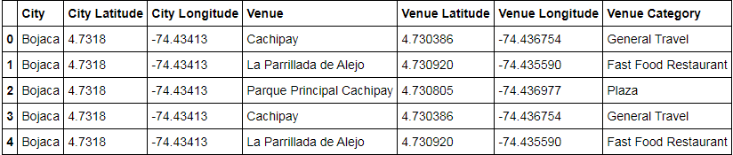
FINDINF THE VENUES OF BOGOTÁ AND CUNDINAMARCA

Slide 5
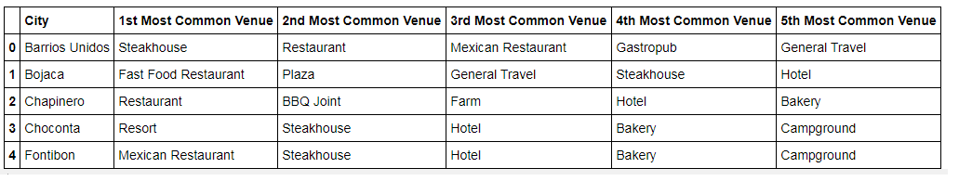
organizing the table to obtain the 5 most common venues of each city or neighborhood

Slide 6
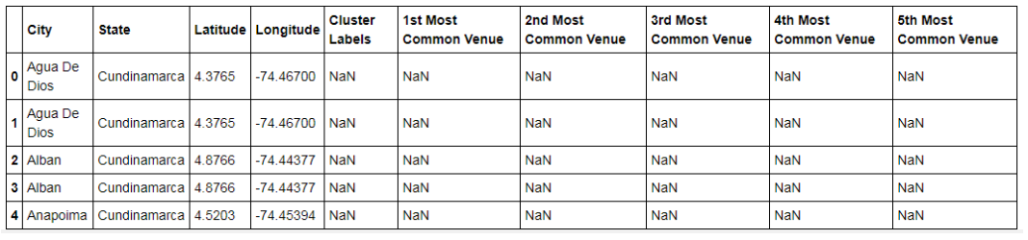
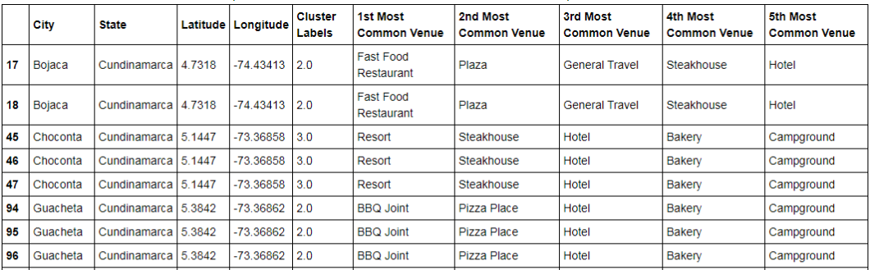
CLEANING NEW TABLE

Slide 7
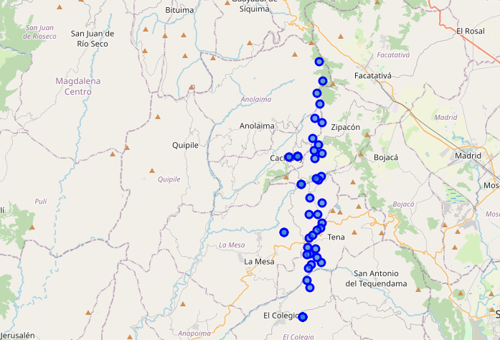
CREATING MAP
Here we can see clusters in Cundinamarca

Slide 8
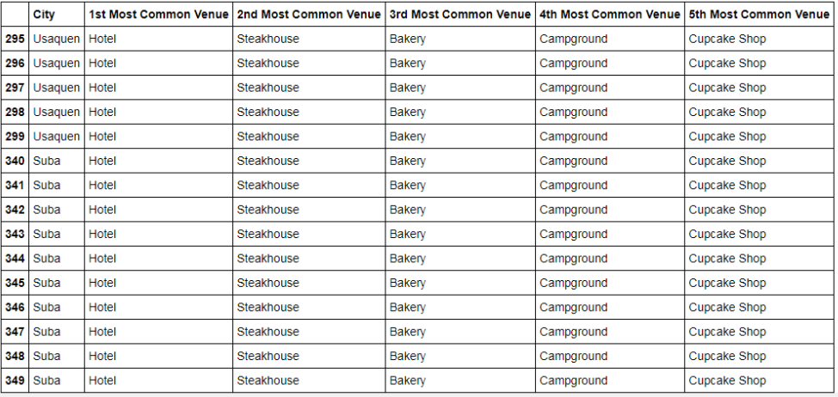
CLUSTER 5

Slide 9
CONCLUSION
that the most frequented places in the cities of Cundinamarca and Bogotá are gastronomic places
The results show the cluster 5 as the most interesting cluster since the gastronomic sector is only below the hotel sector as the most common in the area
Steakhouse is the 2nd most common venue in Suba and Usaquen in Bogotá which is the correct place to stablish a butcher shop as per stakeholder requirements

